Slide 1
Integrated batch and real-time view via lambda architecture

Slide 2
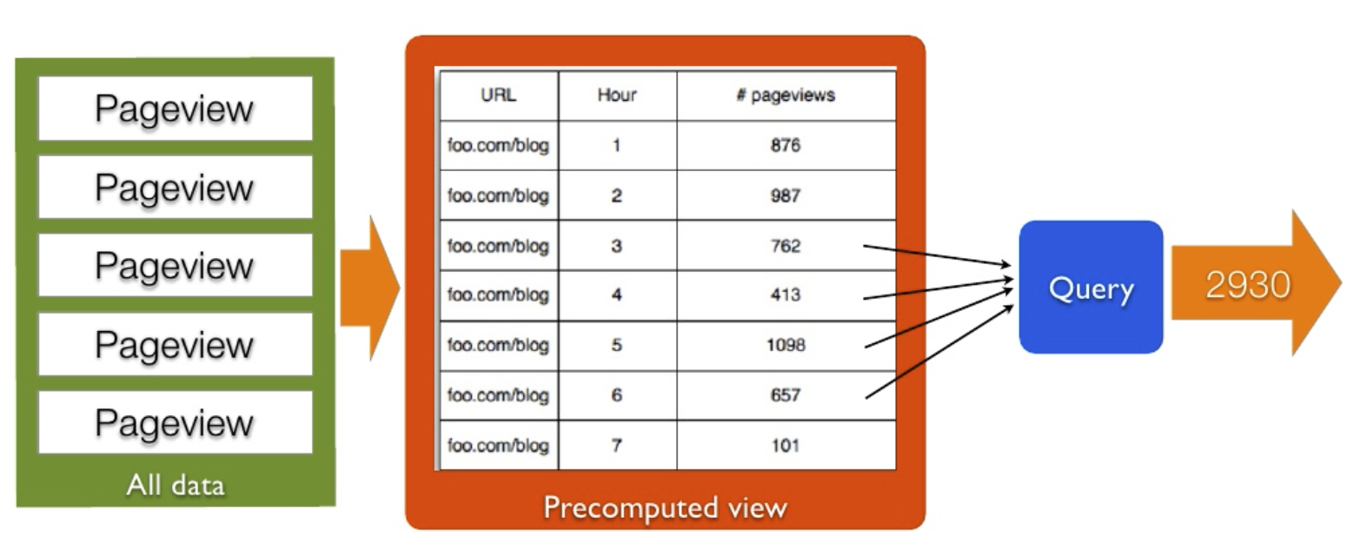
Consider Example
Total number of page views to a URL over a range of time.

Slide 3
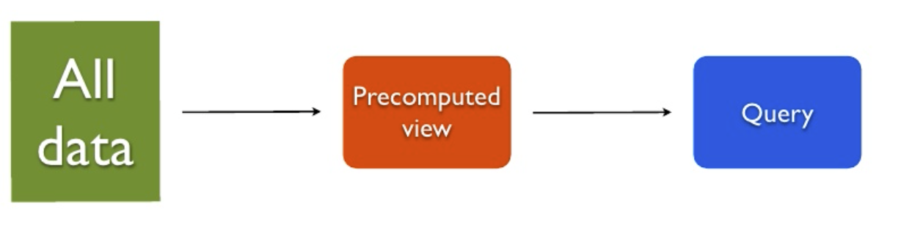
The Usual Hadoop Batch Processing Solution
Process all the data and put it into a precomputed view for querying.
Using MapReduce, Pig, Hive, or etc.
Store the precomputed view into some kind of database.
Like the noSQL store HBase
At query-time we can query the database quickly
Since the database is usually indexed.
E.g. in this case indexed by URL and time.

Slide 4
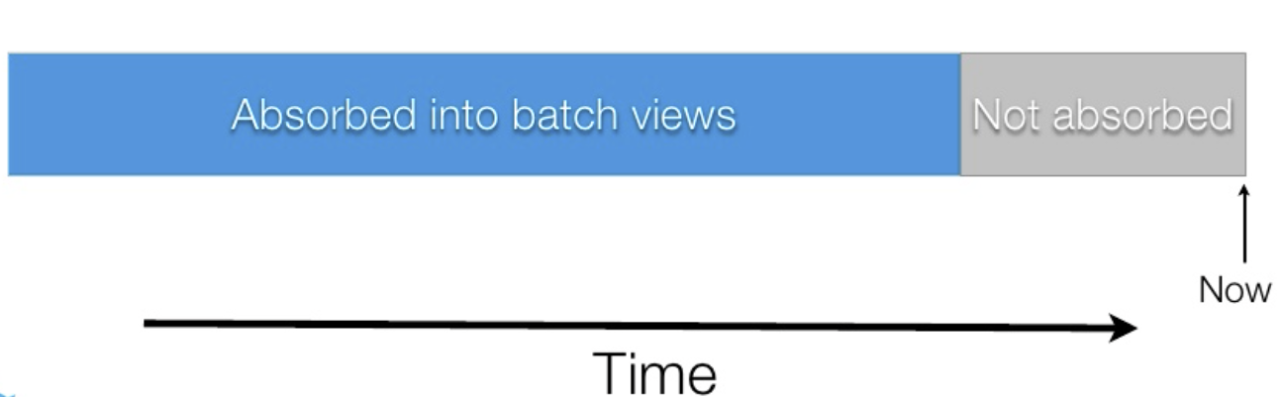
What is wrong with Batch Processing?
Batch processing is too slow.
Views are out-of-date.

Slide 5


Compensating for last few hours of data
New data stream
Realtime View
Storm

Slide 6
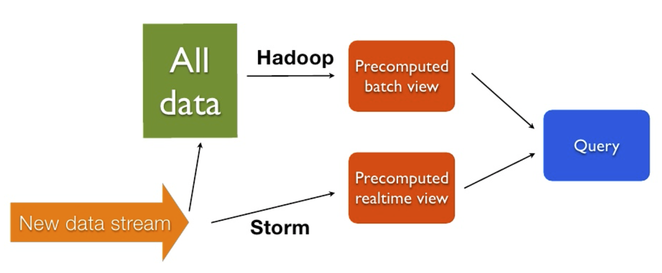
Integrated Batch and Real-time View (Lambda Architecture)

